Slide 1
Big Data Analytics and Mining
Junming Shao

Slide 2
Lecture 4
Sampling for Big Data

Slide 3
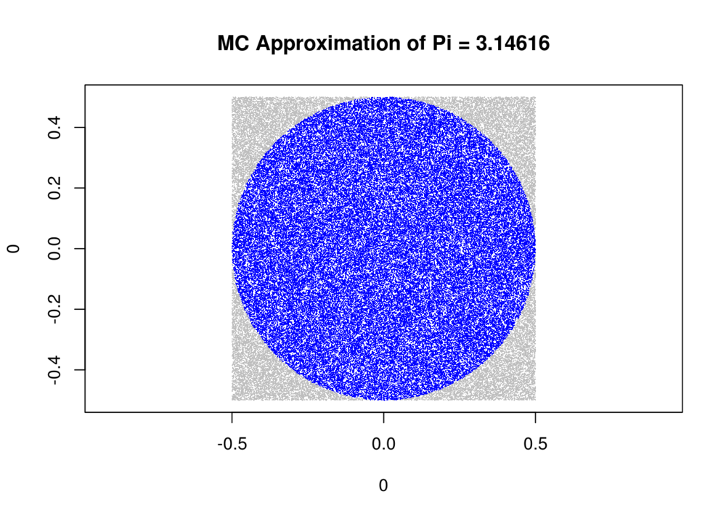
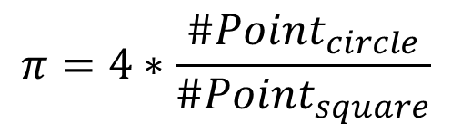
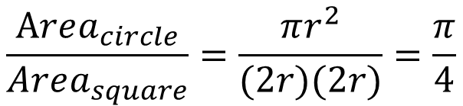
What’s the value of π?
$$\frac{Area_{circle}}{Area_{square}}=\frac{πr^{2}}{(2r)(2r)}=\frac{π}{4}$$
$$π=4∗\frac{\#Point_{circle}}{\#Point_{square}}$$

Slide 4
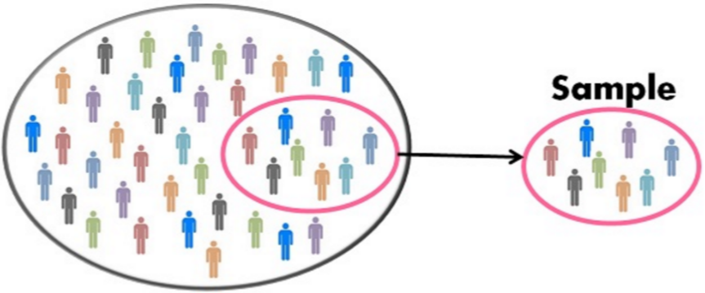
Outline
Motivation / Benefits
Basics of sampling
Inverse Transform sampling
Rejection sampling
Importance sampling
Markov chain Monte Carlo (MCMC)
MH Sampling
Gibbs Sampling
Stream sampling
Conclusion

Slide 5
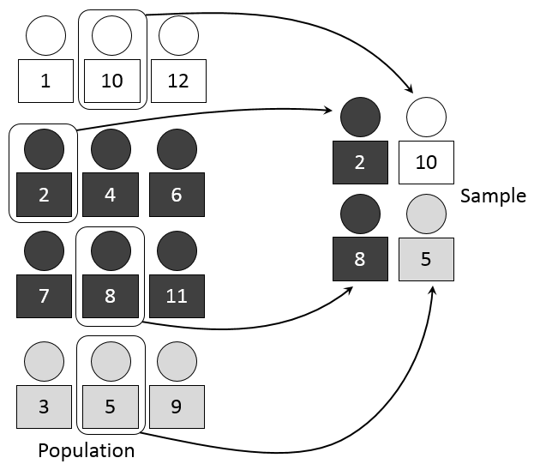
Why Sampling?
Big data issue
Store complexity
Calculate complexity
…
Posterior estimation
Expectation estimation
……
Mean age of people in China
Notes:
问卷调查

Slide 6

Bad Sampling
Perform your research with bad samples, or just ones that are inaccurately designed, and you will almost certainly get misleading results.
Examples: only sample teenagers when querying the mean age of people in China
Notes:
问卷调查

Slide 7
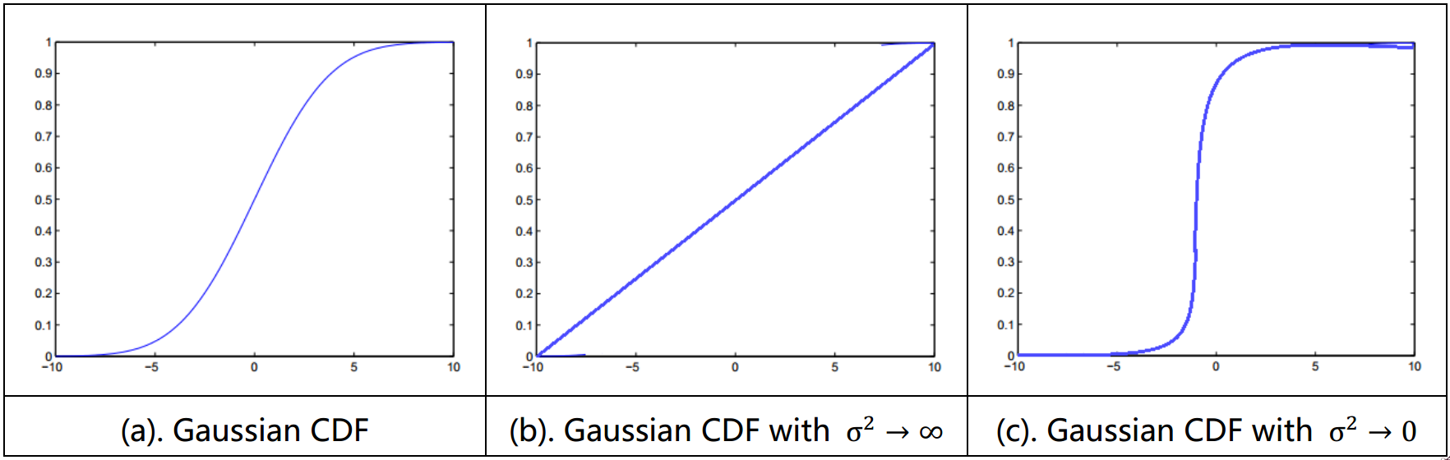
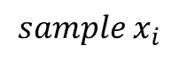
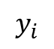
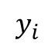
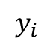
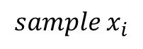
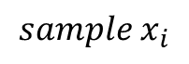
Inverse Transform Sampling
Gaussian distribution
$$y_{i}$$
$$y_{i}$$
$$y_{i}$$
$${sample x}_{i}$$
$${sample x}_{i}$$
$${sample x}_{i}$$

Slide 8
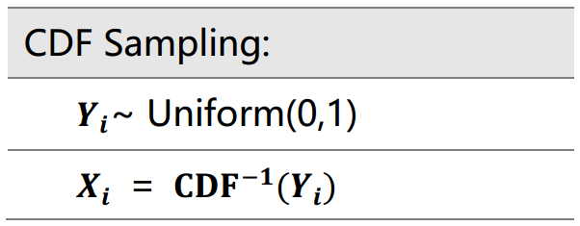
Inverse Transform Sampling
Sampling based on the inverse of Cumulative Distribution Function (CDF)
Method:
Drawbacks：
Usually, it’s hard to get the inverse function

Slide 9
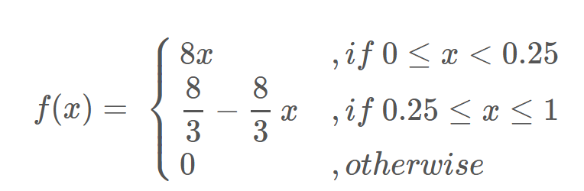
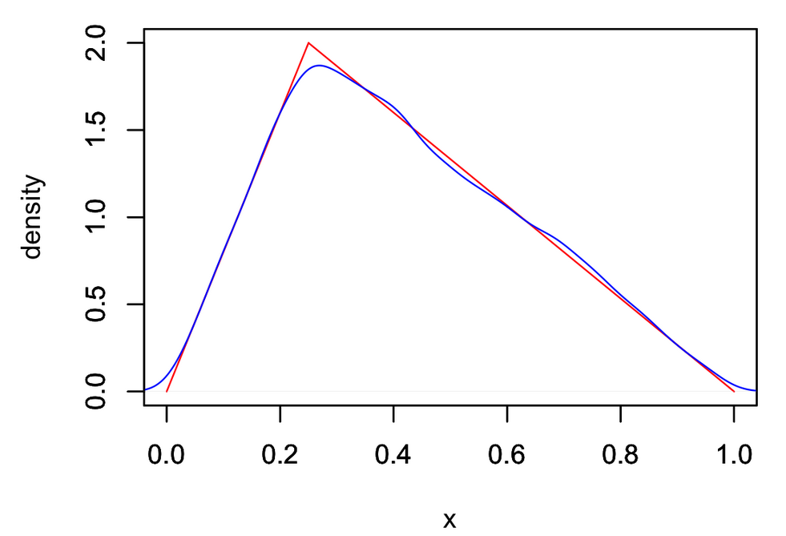
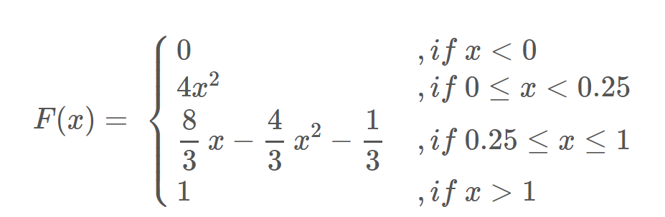
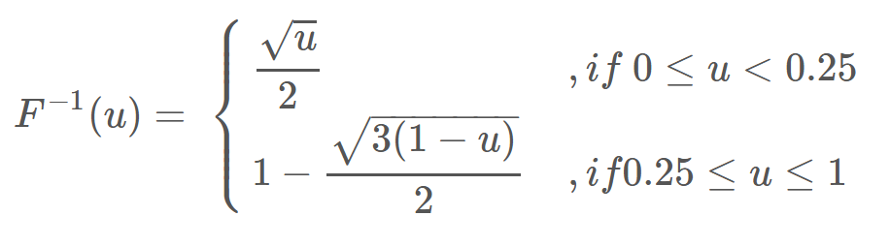
Example 1

Slide 10
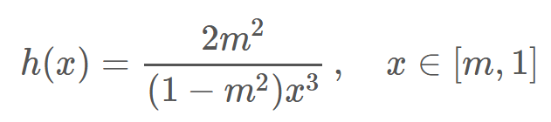
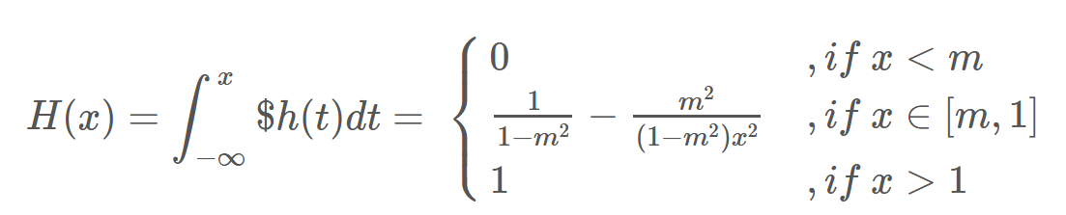
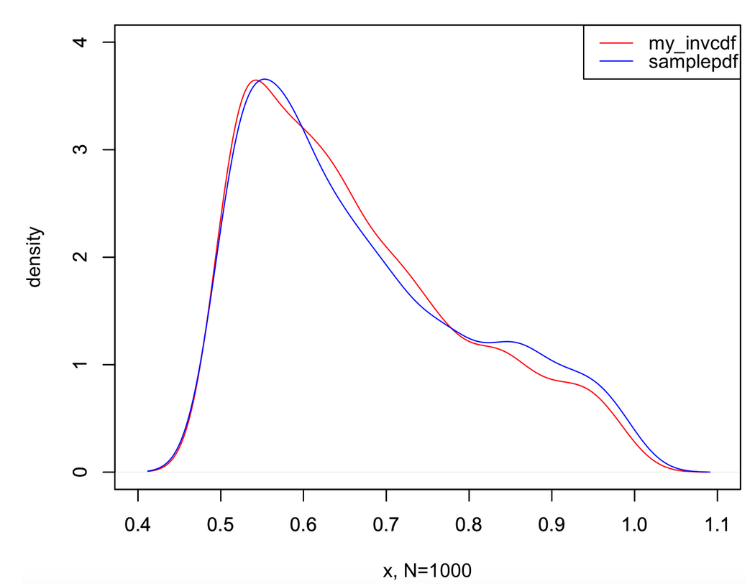
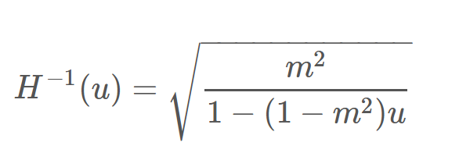
Example 2

Slide 11
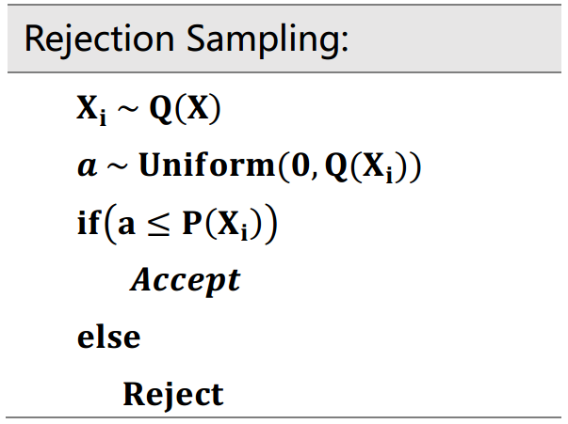
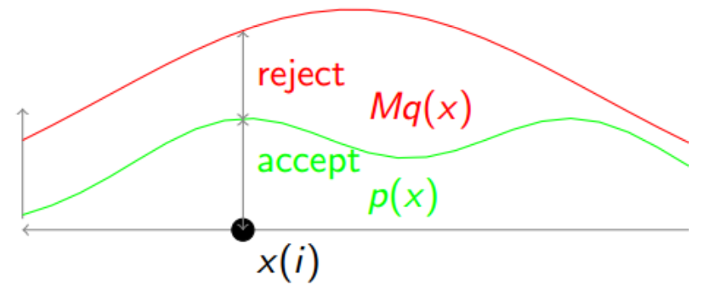
Rejection Sampling
Ideas:
Accept the samples in the region under the graph of its density function and reject others
Proposal distribution Q(x)
Acceptance ratio = p(x)/Mq(x)

Slide 12
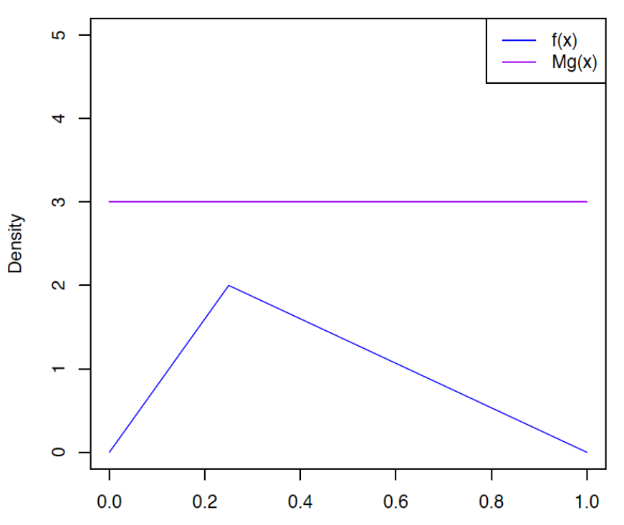
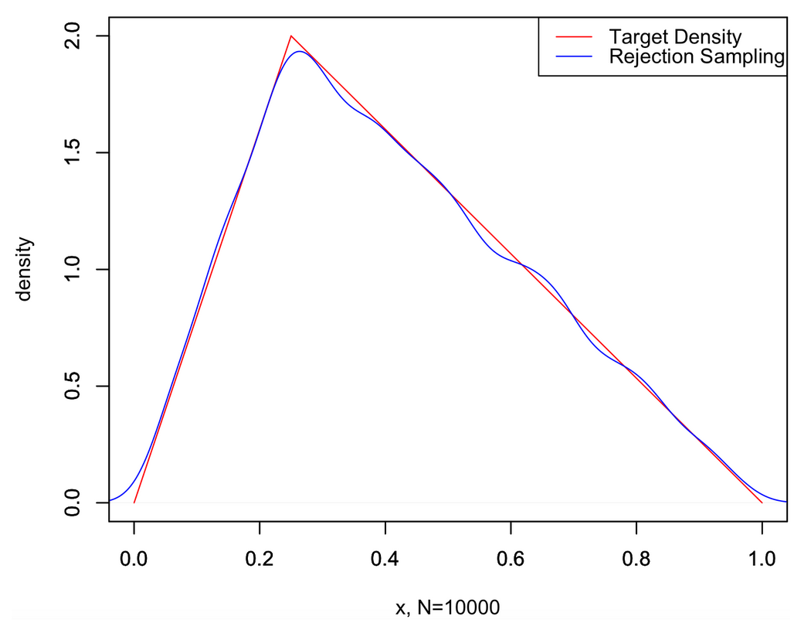
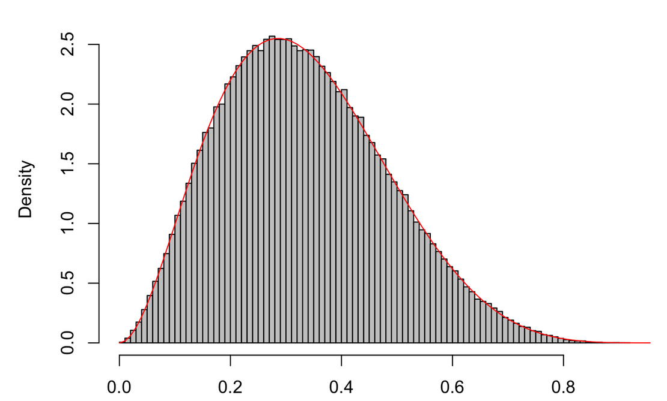
Examples
Beta Distribution

Slide 13
Region Construction: Proposal Distribution
Proposal distribution q(x) should always covers the target distribution p(x). → Possible?
Proposal distribution Q(x)
Big positive number M

Slide 14
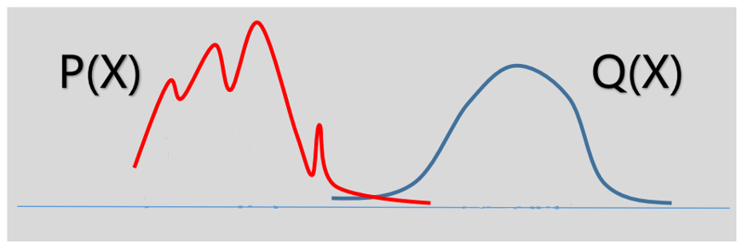
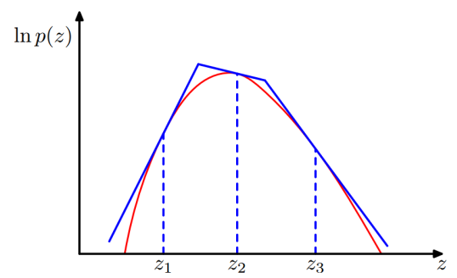
Region Construction: Proposal Distribution
Proposal distribution q(x) should always covers the target distribution p(x). → magnify q(x)
What would happen?
Choice of q(x) matters!
*Adaptive reject sampling
Adaptive construct q(x) by p(x),
if p(x) is log-concave

Slide 15
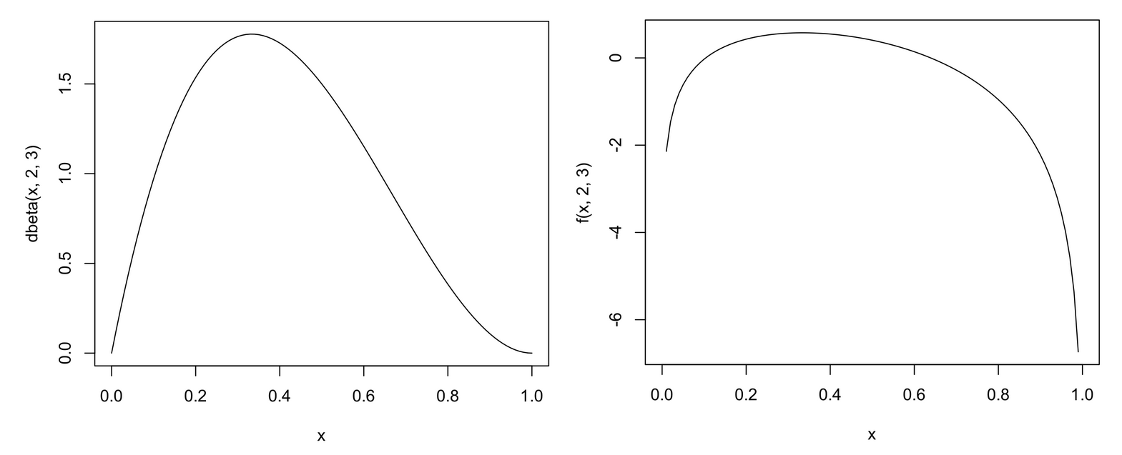
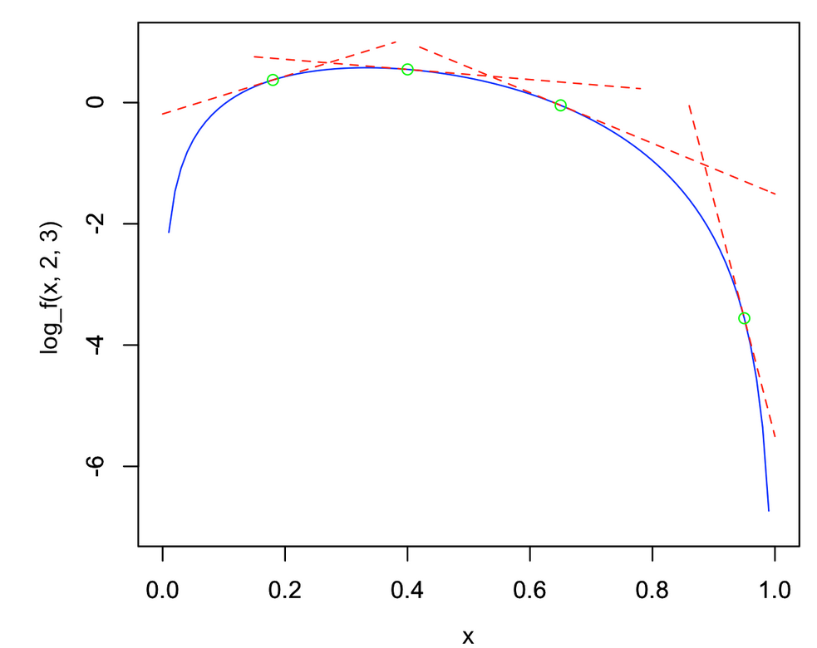
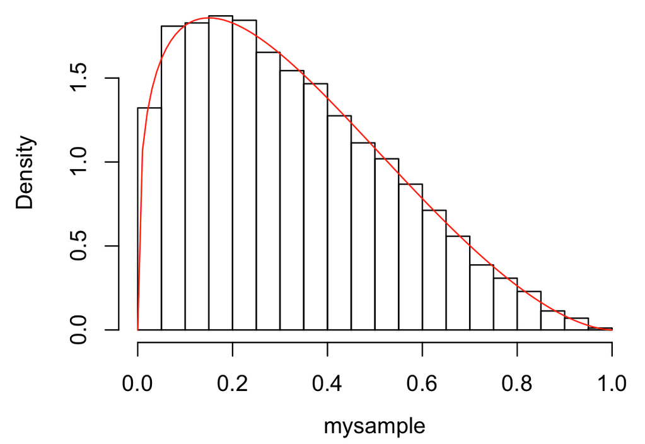
log-concave

Slide 16
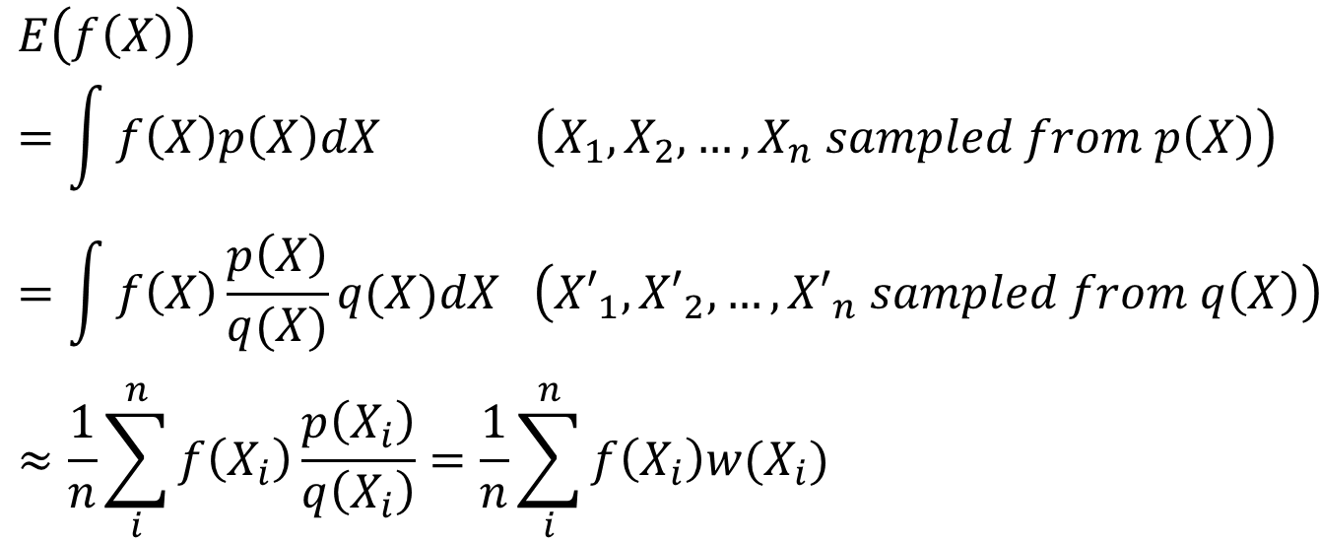
Importance Sampling
Basic Idea: Not reject but assign weight to each instance so that the correct distribution is targeted.
$$E\left(f\left(X\right)\right)=\int{f\left(X\right)p\left(X\right)dX \left(X_{1},X_{2},…,X_{n} sampled from p\left(X\right)\right)}=\int{f\left(X\right)\frac{p\left(X\right)}{q(X)}q(X)dX \left({X′}_{1},{X′}_{2},…,{X′}_{n} sampled from q\left(X\right)\right)}≈\frac{1}{n}\sum_{i}^{n}{f\left(X_{i}\right)\frac{p\left(X_{i}\right)}{q\left(X_{i}\right)}}=\frac{1}{n}\sum_{i}^{n}{f\left(X_{i}\right)w(X_{i})}$$

Slide 17
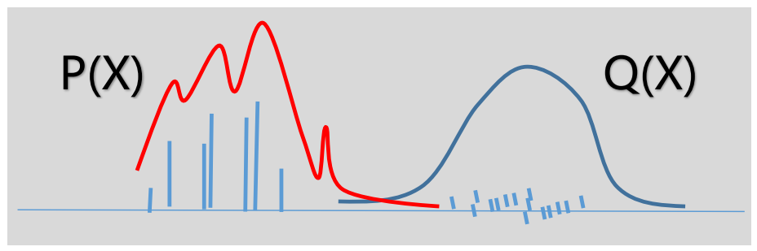
Importance Sampling (IS)
V.S. Rejection Sampling(RS)
Instances from RS share the same “weight”, only some of instances are reserved
Instances from IS have different weight, all instances are reserved
IS is less sensitive to proposal distribution
The length of bar is its weight

Slide 18
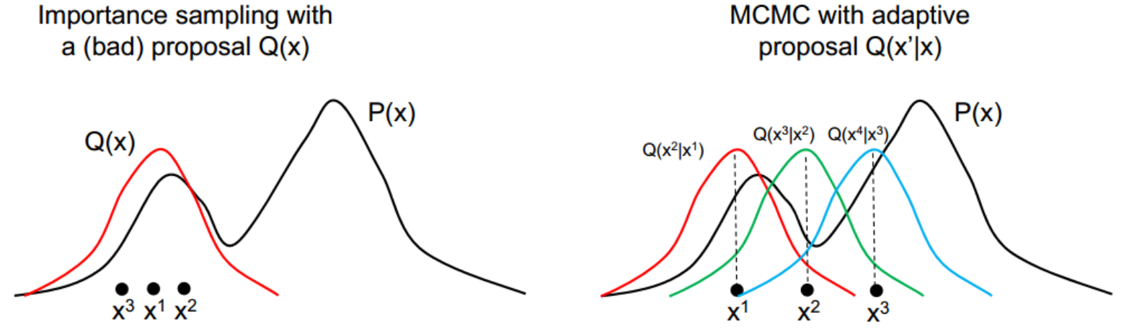
Markov chain Monte Carlo (MCMC)
MCMC methods are a class of algorithms for sampling from a probability distribution based on constructing a Markov chain that has the desired distribution as its equilibrium distribution. The state of the chain after a number of steps is then used as a sample of the desired distribution.

Slide 19
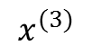
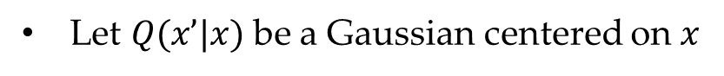
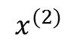
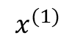
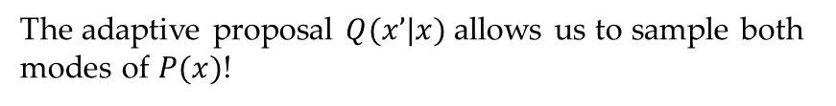
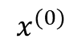
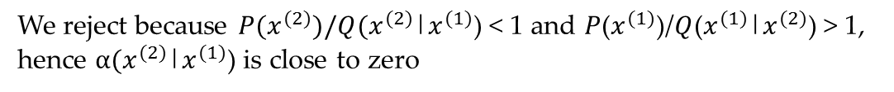
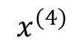
Example:
Let $Q(x’|x)$be a Gaussian centered on $x$
We’re trying to sample from a bimodal distribution $P(x)$
We reject because $P(x^{(2)})/Q(x^{(2)}$|$x^{(1)}$) < 1 and $P$($x^{(1)}$)/$Q$($x^{(1)}$|$x^{(2)}$) > 1,
hence $α(x^{(2)}$|$x^{(1)}$) is close to zero
The adaptive proposal $Q(x’|x)$allows us to sample both modes of $P(x)$!
$$x^{(0)}$$
$$x^{(1)}$$
$$x^{(2)}$$
$$x^{(3)}$$
$$x^{(4)}$$
reject

Slide 20
Markov chain
A Markov chain is a sequence of random variables with Markov property, namely that, given the present state, the future and past states are independent.
Utilize MCMC to generate a Markov chain, such that we have a Markov chain
If n is large enough,
Example: X={e, t, w}

Slide 21
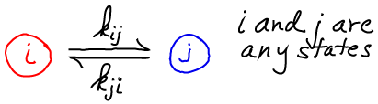
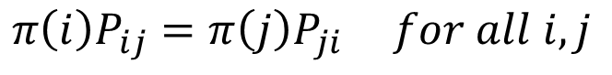
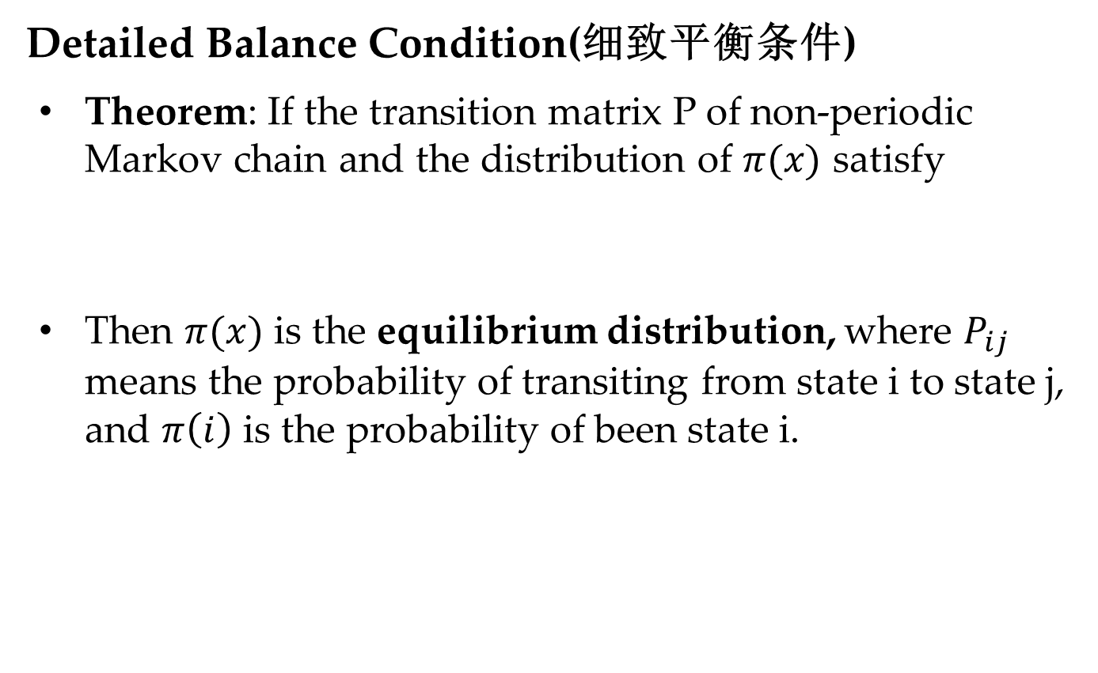
MCMC Basics
Detailed Balance Condition(细致平衡条件)
Theorem: If the transition matrix P of non-periodic Markov chain and the distribution of $π(x)$ satisfy
Then $π(x)$ is the equilibrium distribution, where $P_{ij}$ means the probability of transiting from state i to state j, and $π\left(i\right)$ is the probability of been state i.
$$π\left(i\right)P_{ij}=π\left(j\right)P_{ji} for all i,j$$

Slide 22
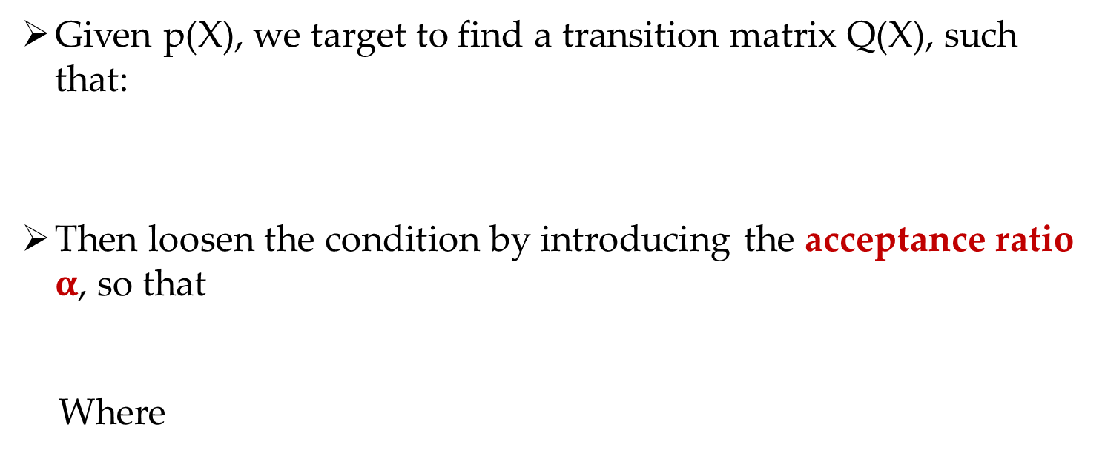
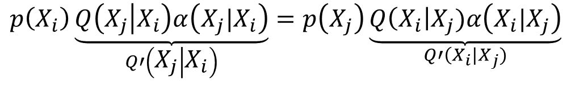
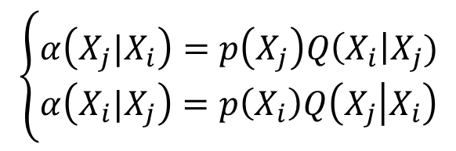
MCMC Sampling
Given p(X), we target to find a transition matrix Q(X), such that:
Then loosen the condition by introducing the acceptance ratio $α$, so that
Where
$$p\left(X_{i}\right)Q\left(X_{j} | X_{i}\right)=p\left(X_{j}\right)Q\left(X_{i}\right|X_{j}) for any i,j$$
$$p\left(X_{i}\right)Q\left(X_{j} | X_{i}\right)α\left(X_{j}|X_{i}\right)=p\left(X_{j}\right)Q\left(X_{i}\right|X_{j})α\left(X_{i}|X_{j}\right)$$
$$\left\{\begin{aligned}α\left(X_{j}|X_{i}\right)=p\left(X_{j}\right)Q\left(X_{i}\right|X_{j}) \\ α\left(X_{i}|X_{j}\right)=p\left(X_{i}\right)Q\left(X_{j} | X_{i}\right)\end{aligned}\right.$$
$$p\left(X_{i}\right)\underset{Q′\left(X_{j} | X_{i}\right)}{\underbrace{Q\left(X_{j} | X_{i}\right)α\left(X_{j}|X_{i}\right)}}=p\left(X_{j}\right)\underset{Q′\left(X_{i}\right|X_{j})}{\underbrace{Q\left(X_{i}\right|X_{j})α\left(X_{i}|X_{j}\right)}}$$

Slide 23
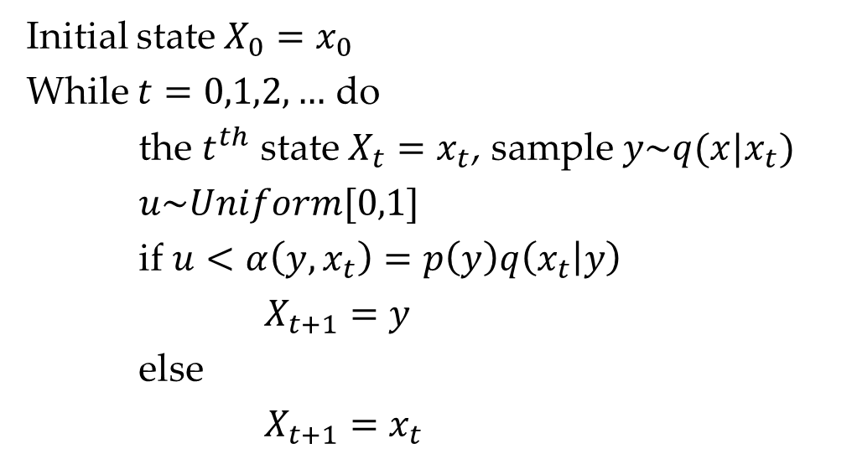
MCMC Sampling
Initial state $X_{0}=x_{0}$
While $t=0,1,2,…$ do
the $t^{th}$ state $X_{t}=x_{t}$, sample $y\sim q(x|x_{t})$
$u\sim Uniform[0,1]$
if $u<α\left({y,x}_{t}\right)=p\left(y\right)q\left(x_{t} | y\right)$
$X_{t+1}=y$
else
$X_{t+1}=x_{t}$
Acceptance ratio would be too small !!

Slide 24
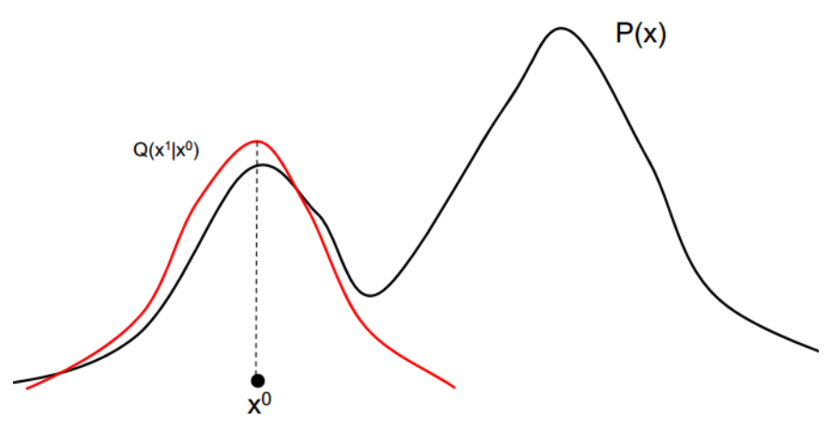



MCMC Example

Slide 25


Metropolis–Hastings (MH) Sampling
Equivalence:
Idea: Magnify acceptance ratio by
Note that it wouldn’t violate the detailed balance condition
$$p\left(X_{i}\right)q\left(X_{j} | X_{i}\right)∗0.1=p\left(X_{j}\right)q\left(X_{i}\right|X_{j})∗0.2$$
$$p\left(X_{i}\right)q\left(X_{j} | X_{i}\right)∗0.5=p\left(X_{j}\right)q\left(X_{i}\right|X_{j})∗1.0$$
$$α\left(X_{j}|X_{i}\right)=min\left(1,\frac{p\left(X_{j}\right)q\left(X_{i}\right|X_{j})}{p\left(X_{i}\right)q\left(X_{j} | X_{i}\right)}\right)$$
$$p\left(X_{i}\right)q\left(X_{j} | X_{i}\right)α\left(X_{j}|X_{i}\right)=p\left(X_{i}\right)q\left(X_{j} | X_{i}\right)min\left(1,\frac{p\left(X_{j}\right)q\left(X_{i}\right|X_{j})}{p\left(X_{i}\right)q\left(X_{j} | X_{i}\right)}\right)$$
$$=\min\left(p\left(X_{i}\right)q\left(X_{j} | X_{i}\right),p\left(X_{j}\right)q\left(X_{i}\right|X_{j})\right)$$
$$=p\left(X_{j}\right)q\left(X_{i}\right|X_{j})min\left(\frac{p\left(X_{i}\right)q\left(X_{j} | X_{i}\right)}{p\left(X_{j}\right)q\left(X_{i}\right|X_{j})},1\right)=p\left(X_{j}\right)q\left(X_{i}\right|X_{j})α\left(X_{i}|X_{j}\right)$$

Slide 26

MH Sampling
Initial state $X_{0}=x_{0}$
While $t=0,1,2,…$ do
the $t^{th}$ state $X_{t}=x_{t}$, sample $y\sim q(x|x_{t})$
$u\sim Uniform[0,1]$
if $u<α\left(x_{t},y\right)=min\left(1,\frac{p\left(y\right)q\left(X_{i}\right|y)}{p\left(X_{i}\right)q\left(y\right|X_{i})}\right)$
$X_{t+1}=y$
else
$X_{t+1}=x_{t}$
Acceptance ratio still isn’t 100% !!

Slide 27




Gibbs Sampling
Idea:
MH has large acceptance ratio, Gibbs sampling further make acceptance ratio being 100%
Two-dimension example
Given a joint distribution p(x, y), corresponding to the point in the figure below, $A(x_{1}, y_{1})$ and $B(x_{1},y_{2})$
$$\left\{\begin{aligned}p\left(x_{1},y_{1}\right)p\left(y_{2} | x_{1}\right)=p\left(x_{1}\right)p\left(y_{1} | x_{1}\right)p(y_{2}|x_{1}) \\ p\left(x_{1},y_{2}\right)p\left(y_{1} | x_{1}\right)=p\left(x_{1}\right)p\left(y_{2} | x_{1}\right)p(y_{1}|x_{1})\end{aligned}\right.$$
$$p\left(x_{1},y_{1}\right)p\left(y_{2} | x_{1}\right)=p\left(x_{1},y_{2}\right)p\left(y_{1} | x_{1}\right)$$
$$p\left(A\right)p\left(y_{2} | x_{1}\right)=p\left(B\right)p\left(y_{1} | x_{1}\right)$$

Slide 28

Gibbs Sampling
Steps:
Initial $\left\{x_{i}:i=0,…,n\right\}$
While $t=0,1,2,…$ , do
$$x_{1}^{(t+1)}\sim p(x_{1}|x_{2}^{\left(t\right)},x_{3}^{\left(t\right)},…,x_{n}^{(t)})$$
$$x_{2}^{(t+1)}\sim p(x_{2}|x_{1}^{\left(t\right)},x_{3}^{\left(t\right)},…,x_{n}^{(t)})$$
……
Like every other MCMC style algorithm, Gibbs sampling still have the burn-in period

Slide 29
Example:
X={e, t, w}
Step 1: Initialize e, t, and w, such that we have
Step 2: generate based on
Step 3: generate based on
Step 4: generate based on
Step 5: repeat steps 2-4 n times, and we obtain a Markov chain

Slide 30




Latent Dirichlet allocation
隐含狄利克雷分布
Documents are represented as random mixtures over latent topics, where each topic is characterized by a distribution over all the words.

Slide 31




Inference
intractable
Maximum Likelihood Estimation does not work now!!
Variational inference
Gibbs Sampling
Topic Assignment
Topic-word Matrix
Document-Topic Matrix

Slide 32









Please refer to: https://zhuanlan.zhihu.com/p/172021192
Conditional distribution

Slide 33

LDA-Gibbs采样 （Wikipedia）

Slide 34

Gibbs V.S. MH
MH
Doesn’t have a 100% acceptance rate,
Doesn’t require to know the full conditionals $p(x_{i}|x_{1}^{\left(t\right)},…,x_{i−1}^{\left(t\right)},x_{t+1}^{(t)}…,x_{n}^{(t)})$,
Acceptance threshold would be very crucial
Gibbs
100% acceptance rate
Need to know the full conditionals

Slide 35
Sampling on Data Stream

Slide 36
Bernoulli Sampling
The easiest possible case of sampling: all weights are 1
N objects, and want to sample k from them uniformly
Each possible subset of k should be equally likely
Uniformly sample an index from N (without replacement) k times
Some subtleties: truly random numbers from [1…N] on a computer?
Assume that random number generators are good enough
Common trick in DB: assign a random number to each item and sort
Costly if N is very big, but so is random access
Interesting problem: take a single linear scan of data to draw sample
Streaming model of computation: see each element once
Application: IP flow sampling, too many (for us) to store
(For a while) common tech interview question

Slide 37
Reservoir Sampling
Fixed k uniform sample from arbitrary size N stream in one pass
No need to know stream size in advance
Include first k items w.p. 1
Include item n > k with probability p(n) = k/n, n > k
Pick j uniformly from {1,2,…,n}
If j ≤ k, swap item n into location j in reservoir, discard replaced item
Neat proof shows the uniformity of the sampling method:
Let S_{n} = sample set after n arrivals
m (< n)
New item: selection probability
Prob[n ∈ S_{n} ] = p_{n} := k/n
k=7
n

Slide 38

Sampling + KDD
The interplay between sampling and data mining is not well understood
Need an understanding of how ML/DM algorithms are affected by sampling
E.g. how big a sample is needed to build an accurate classifier?
E.g. what sampling strategy optimizes cluster quality
Expect results to be method specific
I.e. “IPPS + k-means” rather than “sample + cluster”

Slide 39
Acknowledgement
Partial material of Slides are from
http://blog.csdn.net/baimafujinji/article/details/51407703
www.kdd.org/kdd2014/tutorials/t10_part1.pptx

Slide 40
Take Home Message
Inverse Transform sampling
Rejection sampling
Importance sampling
Markov chain Monte Carlo (MCMC)
MH Sampling
Gibbs Sampling
Reservoir sampling

Slide 41
Thanks !!!

